Slide 1
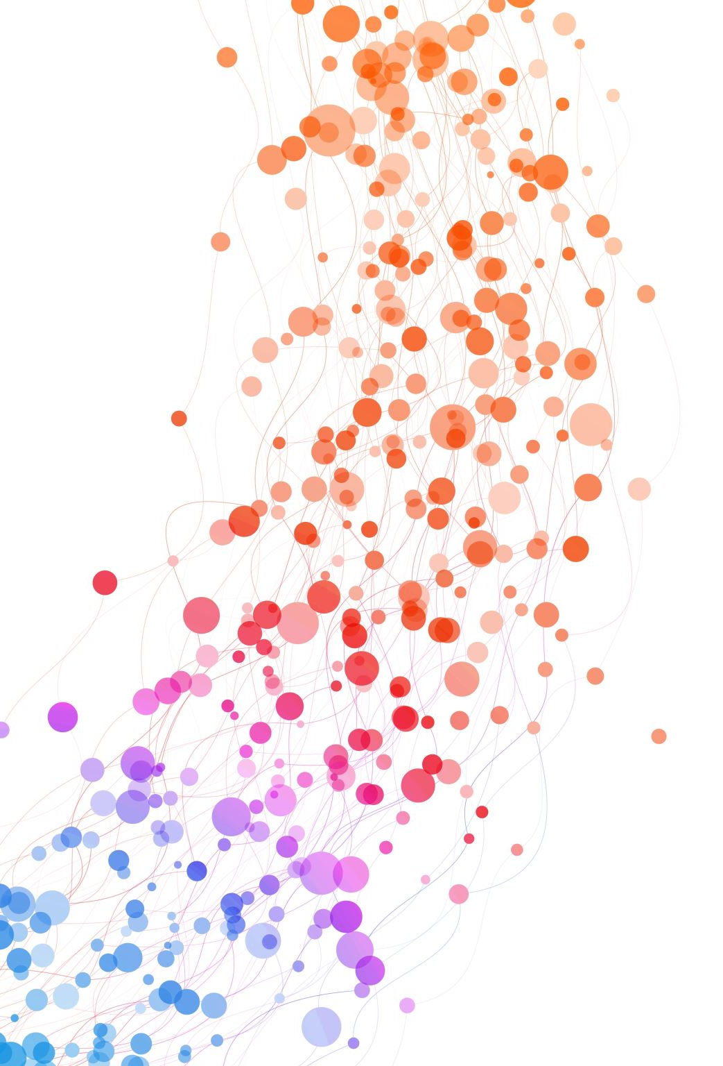
Dynamic Matching of Users and Creators on Social Media Platforms
Daniel Huttenlocher, Hannah Li, Liang “Charles” Lyu, Asuman Ozdaglar, James Siderius
MIT

Slide 2




Social Media and Recommendations

Slide 3



Social Media and Recommendations

Slide 4
Social Media and Recommendations
Platform
Recommendations

Slide 5

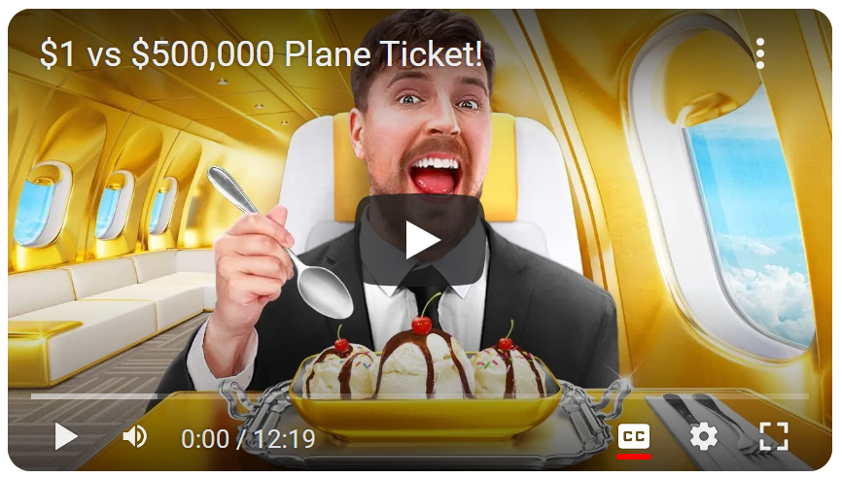
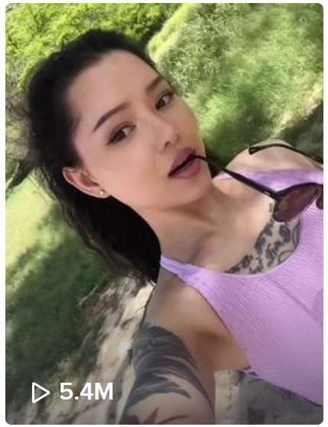
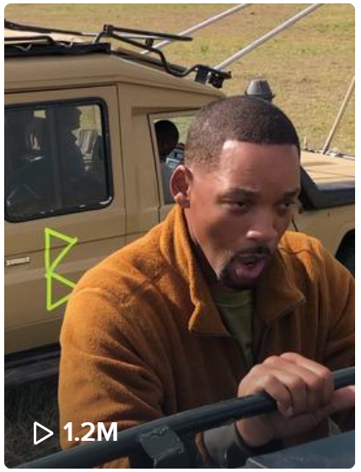


Traditional Literature and Practice
BEST
BEST
“Predicting what you’re most likely to be interested in or engage with” (2021)
BEST
Focus on
user preferences
“Trained on Tweet interactions to optimize for positive engagement (e.g. Likes, Retweets, and Replies)” (2023)

Slide 6
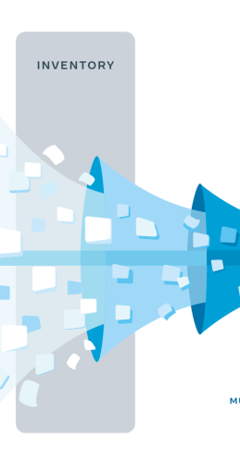

Traditional Literature and Practice
$⇒$ “Inventory”
BEST
BEST
BEST
Focus on
user preferences
Assume
fixed content pool

Slide 7
Traditional Literature and Practice
Stay or leave? What to produce?
How much?
BEST
BEST
!
BEST
Focus on
user preferences
Neglect
Creator incentives

Slide 8
Recent Literature
Stay or leave? What to produce?
How much?
[Mladenov et al. 2020] [Jagadeesan et al. 2023] [Zhu et al. 2023]
and more…
Considers
Creator incentives

Slide 9
Recent Literature
Stay or leave? What to consume?
How much?
Stay or leave? What to produce?
How much?
!
Neglects
User incentives
(or not a main focus)
Considers
Creator incentives

Slide 10
Our work…
Stay or leave? What to consume?
How much?
Incentives from BOTH sides
(Departures)
Stay or leave? What to produce?
How much?
User incentives
Creator incentives

Slide 11

Dynamics of Content Matching
1
2 views
2
1
2
3 views
3
1
2 views
2
1
1 view
Creator leaves
(Small audience)

Slide 12
Cascade of Departures
…
Unsatisfied with this recommendation
Creator leaves
(Small audience)
User leaves
(Bad recommendations)
Creator leaves
(Small audience)

Slide 13
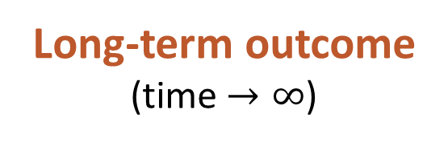
Cascade of Departures
…
Creator leaves
(Small audience)
User leaves
(Bad recommendations)
Long-term outcome
(time $→∞$)

Slide 14
Our Questions
How can a platform maximize long-term engagement?
How badly can a user-centric recommendation algorithm do in the long run?
Long-term outcome
(time $→∞$)

Slide 15
Related Literature
Content recommendation with creator incentives:
[Mladenov et al. 2020]: Matching with creator departures
[Jagadeesan et al. 2023]: Creator preferences and equilibria (no departures)
[Zhu et al. 2023]: Platform learning creator preferences using contracts
Our model:
Departures of both users and creators
Fixed, known user and creator preferences (no learning or adaptation)
Platform maximizes long-term engagement directly
Other literature: Matching in two-sided markets, Generalized Assignment Problem

Slide 16
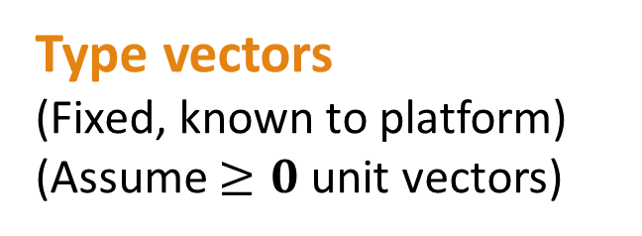
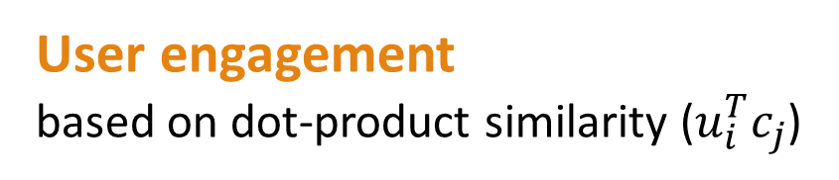
Our Model
(1, 0)
(1, 0)
(0.9, 0.44)
(0.8, 0.6)
Type vectors
(Fixed, known to platform)
(Assume $≥0$ unit vectors)
(0.5, 0.87)
(0.6, 0.8)
(0, 1)
(0, 1)
User engagement
based on dot-product similarity ($u_{i}^{T}c_{j}$)

Slide 17



Our Model
…
$$t=0$$
$$t=1$$
$$t=2$$
Sequential recommendations

Slide 18
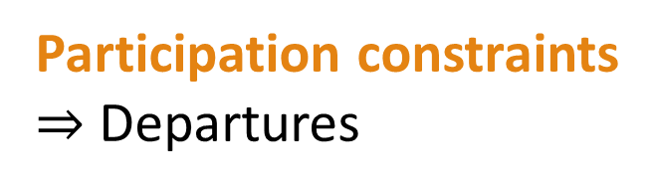
Our Model
…
Participation constraints
$⇒$ Departures
Need enough users
Need enough engagement

Slide 19
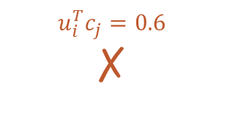
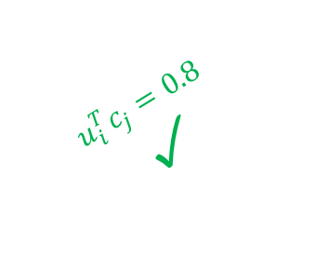



Our Model
User Constraints
At each time step, user $i$ needs:
$K$ recommendations (# creators) (Quantity & Capacity)
$≥{\overline{e}}_{i}$ engagement (dot product) from each creator (Quality)
If violated, leave after this time step
(1, 0)
(1, 0)
(0.9, 0.44)
(0.8, 0.6)
$$u_{i}^{T}c_{j}=0.6$$
✗
(0.5, 0.87)
(0.6, 0.8)
$$u_{i}^{T}c_{j}=0.8$$
✓
(0, 1)
$${\overline{e}}_{i}=0.7$$
$K=2$ (all users)

Slide 20
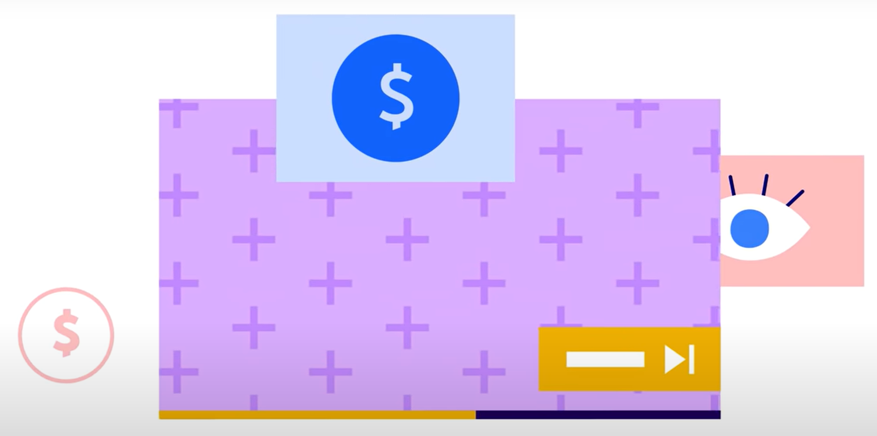
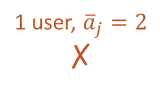

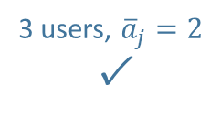
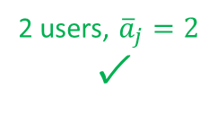
Our Model
Creator Constraints
At each time step, creator $j$ needs:
$≥{\overline{a}}_{j}$ audience size (# users) (Quantity only)
If violated, leave after this time step
1
2
1
3 users, ${\overline{a}}_{j}=2$
✓
2
3
Ad revenue
from users clicking on ads
1
2 users, ${\overline{a}}_{j}=2$
✓
2
1
1 user, ${\overline{a}}_{j}=2$
✗
Views
from YouTube Premium users

Slide 21

Our Model
…
…
Our goal (platform’s goal):
Maximize long-term total engagement
$$t=0$$
$$t=∞$$

Slide 22

Our Model
Total Engagement
Given time horizon $T$, platform maximizes average engagement in $T$ time steps:
$$\frac{1}{T}\sum_{t=0}^{T−1}{\text{Engagement}\left(t\right)}$$
Immediate Engagement: $T=1$
Long-term Engagement: $T→∞$
Our goal (platform’s goal):
Maximize long-term total engagement
$$t=∞$$

Slide 23
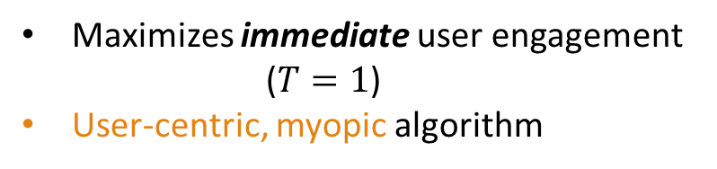
Benchmarks – What the platform might do
Immediate Engagement (IE)
(User-centric)
#1
#2
…
#K
Maximizes immediate user engagement ($T=1$)
User-centric, myopic algorithm

Slide 24
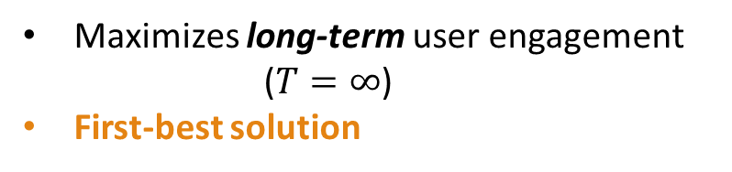
Benchmarks – What the platform might do
Immediate Engagement (IE)
(User-centric)
Forward-Looking (FL)
#1
#2
…
#K
Maximizes immediate user engagement ($T=1$)
User-centric, myopic algorithm
Maximizes long-term user engagement ($T=∞$)
First-best solution

Slide 25
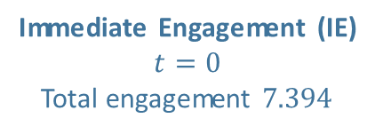
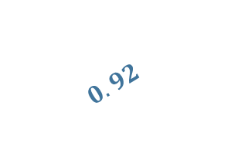
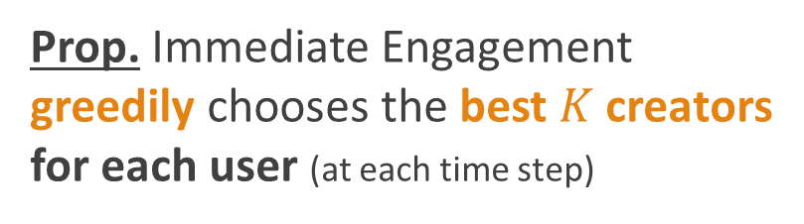

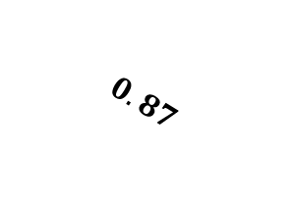
Difference between IE and FL
#2
#2 ✓
$$0.92$$
Prop. Immediate Engagement
greedily chooses the best $K$ creators for each user (at each time step)
$$0.99$$
#1
#1 ✓
$$0.87$$
#3
#3 ✗
Immediate Engagement (IE)
$$t=0$$
Total engagement $7.394$

Slide 26
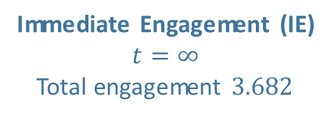
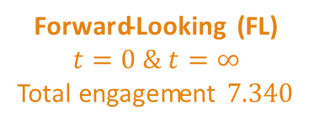
Difference between IE and FL
Immediate Engagement (IE)
$$t=0$$
Total engagement $7.394$
Immediate Engagement (IE)
$$t=∞$$
Total engagement $3.682$
Forward-Looking (FL)
$$t=0 \& t=∞$$
Total engagement $7.340$

Slide 27
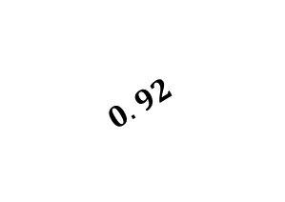

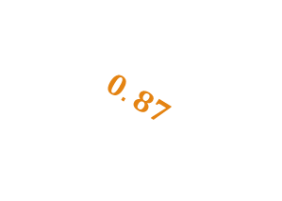
Difference between IE and FL
#2
$$0.92$$
$$0.92$$
$$0.99$$
#1
$$0.99$$
$$0.87$$
#3
$$0.87$$
Immediate Engagement (IE)
$$t=0$$
Total engagement $7.394$
Immediate Engagement (IE)
$$t=∞$$
Total engagement $3.682$
Forward-Looking (FL)
$$t=0 \& t=∞$$
Total engagement $7.340$

Slide 28
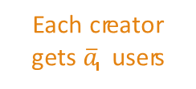
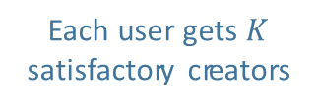
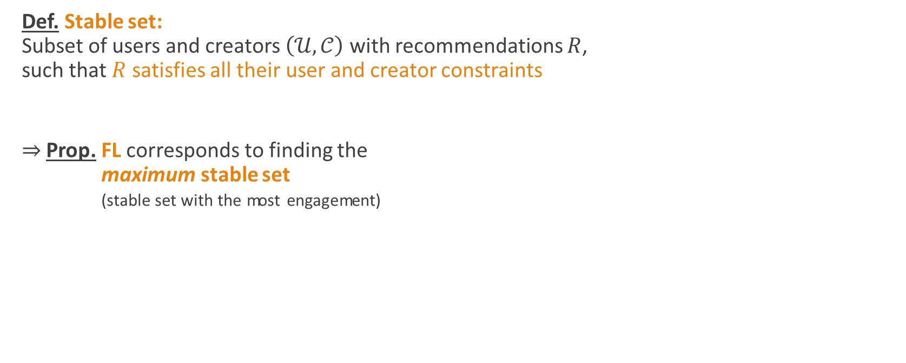
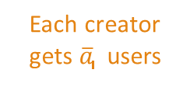
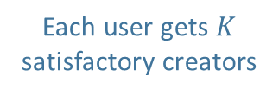
What does Forward-Looking do?
Def. Stable set: Subset of users and creators $\left(𝒰,𝒞\right)$ with recommendations $R$, such that $R$ satisfies all their user and creator constraints
$⇒$ Prop. FL corresponds to finding the $⇒$ Prop. maximum stable set $⇒$ Prop. (stable set with the most engagement)
Each user gets $K$ satisfactory creators
Each creator gets ${\overline{a}}_{j}$ users
Each user gets $K$ satisfactory creators
Each creator gets ${\overline{a}}_{j}$ users

Slide 29
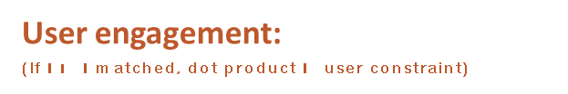
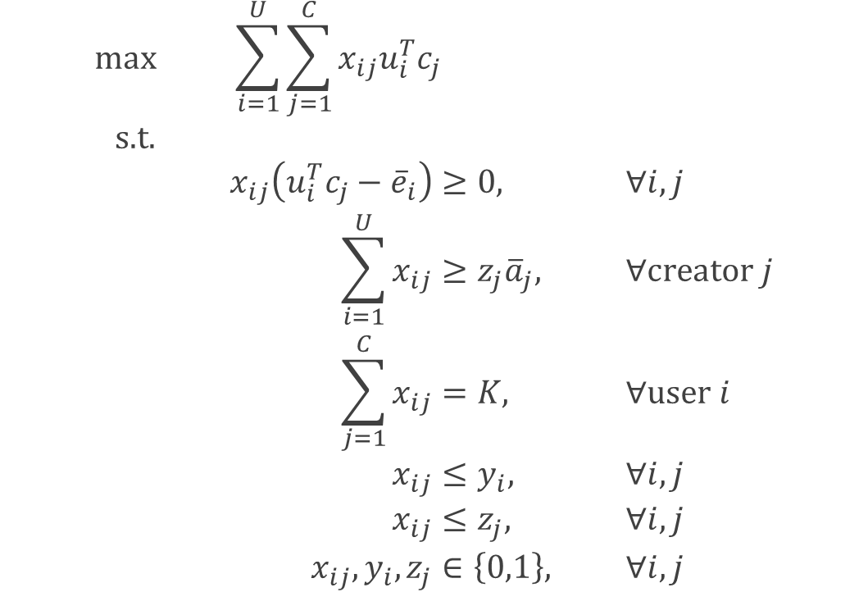


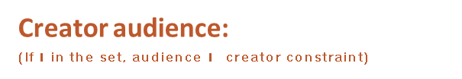
ILP for Max Stable Set & Forward-Looking
$⇒$ Max total engagement
$$\begin{aligned}\text{max}& &\sum_{i=1}^{U}{\sum_{j=1}^{C}{x_{ij}u_{i}^{T}c_{j}}}&&& \\ \text{s}\text{.}\text{t}\text{.}& \\ &&x_{ij}\left(u_{i}^{T}c_{j}−{\overline{e}}_{i}\right)&≥0,& &∀i,j \\ &&\sum_{i=1}^{U}{x_{ij}}&≥z_{j}{\overline{a}}_{j},&&∀\text{creator} j \\ &&\sum_{j=1}^{C}{x_{ij}}&=K,&&∀\text{user} i \\ &&x_{ij}&≤y_{i},&&∀i,j \\ &&x_{ij}&≤z_{j},&&∀i,j \\ &&x_{ij},y_{i},z_{j}&∈\left\{0,1\right\},&&∀i,j\end{aligned}$$
User engagement:
(If $i−j$ matched, dot product $≥$ user constraint)
Creator audience:
(If $j$ in the set, audience $≥$ creator constraint)
Each user gets $K$ creators:

Slide 30





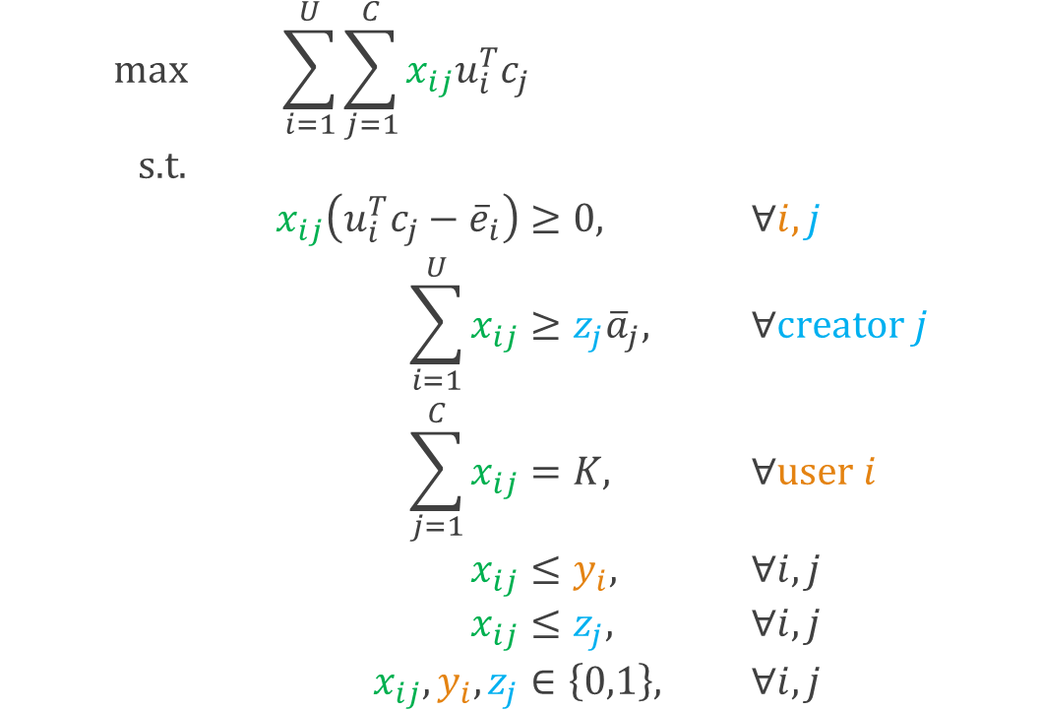
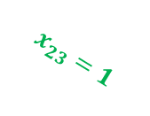
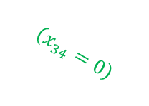



ILP for Max Stable Set & Forward-Looking
$$x_{ij}=1\left[i \text{matched} \text{to} j\right]$$
$⇒$ Max total engagement
$$\begin{aligned}\text{max}& &\sum_{i=1}^{U}{\sum_{j=1}^{C}{x_{ij}u_{i}^{T}c_{j}}}&&& \\ \text{s}\text{.}\text{t}\text{.}& \\ &&x_{ij}\left(u_{i}^{T}c_{j}−{\overline{e}}_{i}\right)&≥0,& &∀i,j \\ &&\sum_{i=1}^{U}{x_{ij}}&≥z_{j}{\overline{a}}_{j},&&∀\text{creator} j \\ &&\sum_{j=1}^{C}{x_{ij}}&=K,&&∀\text{user} i \\ &&x_{ij}&≤y_{i},&&∀i,j \\ &&x_{ij}&≤z_{j},&&∀i,j \\ &&x_{ij},y_{i},z_{j}&∈\left\{0,1\right\},&&∀i,j\end{aligned}$$
$$z_{1}=1$$
User engagement:
(If $i−j$ matched, dot product $≥$ user constraint)
$$x_{22}=0$$
$$x_{23}=1$$
Creator audience:
(If $j$ in the set, audience $≥$ creator constraint)
$$y_{3}=1$$
$$\left(x_{34}=0\right)$$
Each user gets $K$ creators:
$$y_{4}=0$$
$$z_{4}=0$$
$$y_{i}=1\left[i∈𝒰\right]$$
$$z_{j}=1\left[j∈𝒞\right]$$

Slide 31
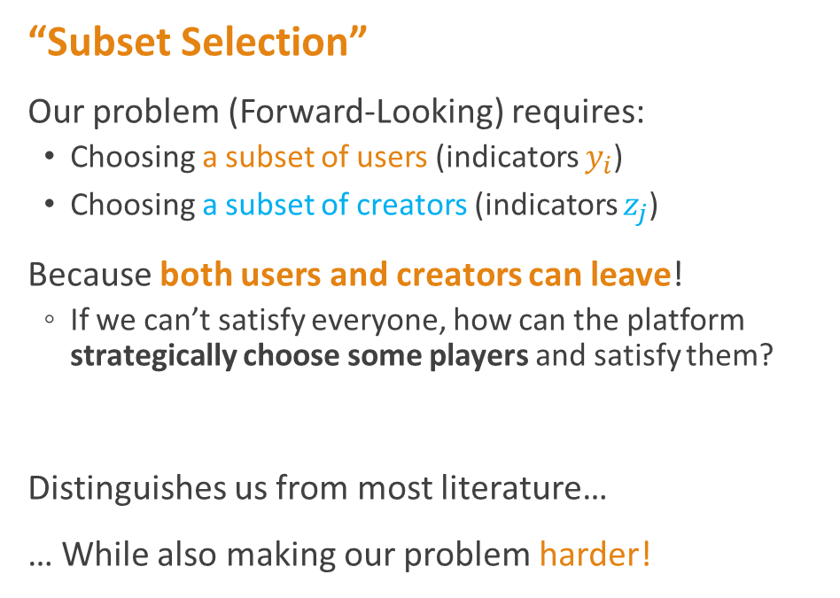
ILP for Max Stable Set & Forward-Looking
“Subset Selection”
Our problem (Forward-Looking) requires:
Choosing a subset of users (indicators $y_{i}$)
Choosing a subset of creators (indicators $z_{j}$)
Because both users and creators can leave!
If we can’t satisfy everyone, how can the platform strategically choose some players and satisfy them?
Distinguishes us from most literature…
… While also making our problem harder!
$$z_{1}=1$$
$$y_{3}=1$$
$$y_{4}=0$$
$$z_{4}=0$$
$$y_{i}=1\left[i∈𝒰\right]$$
$$z_{j}=1\left[j∈𝒞\right]$$

Slide 32
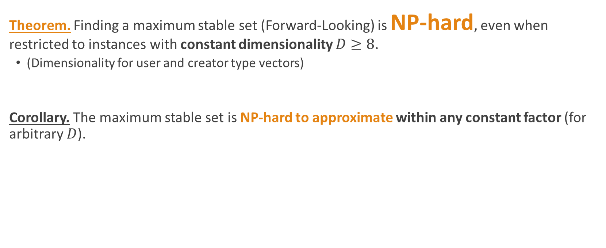
NP-Hardness of Forward-Looking
Theorem. Finding a maximum stable set (Forward-Looking) is NP-hard, even when restricted to instances with constant dimensionality $D≥8$.
(Dimensionality for user and creator type vectors)
Corollary. The maximum stable set is NP-hard to approximate within any constant factor (for arbitrary $D$).

Slide 33

NP-Hardness of Forward-Looking
Reduce from maximum independent set (MIS) on regular graphs and bounded degree graphs
NP-hard for regular graphs with degree $≥3$
NP-hard to approximate within a constant factor
Any 3-regular graph
Independent set

Slide 34
NP-Hardness of Forward-Looking
Reduce from maximum independent set (MIS) on regular graphs and bounded degree graphs
Each user gets 1 recommendation
Each creator requires 3 users
Type vectors? Later…
Any 3-regular graph
User-creator instance
that we construct

Slide 35
NP-Hardness of Forward-Looking
Reduce from maximum independent set (MIS) on regular graphs and bounded degree graphs
Each user gets 1 recommendation
Each creator requires 3 users
Each user (edge) is only satisfied with incident vertices
(achieved using type vectors)
And can only choose one vertex
Any 3-regular graph
User-creator instance
that we construct

Slide 36
NP-Hardness of Forward-Looking
Reduce from maximum independent set (MIS) on regular graphs and bounded degree graphs
Each user gets 1 recommendation
Each creator requires 3 users
Each creator (vertex)’s only potential audience are its incident edges
(achieved using type vectors)
And requires all 3 incident edges
Any 3-regular graph
User-creator instance
that we construct

Slide 37
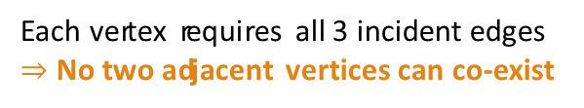
NP-Hardness of Forward-Looking
Reduce from maximum independent set (MIS) on regular graphs and bounded degree graphs
Each user gets 1 recommendation
Each creator requires 3 users
Each edge can only choose one vertex
Each vertex requires all 3 incident edges
$⇒$ No two adjacent vertices can co-exist
✓
✗
✗
Any 3-regular graph
User-creator instance
that we construct

Slide 38

NP-Hardness of Forward-Looking
Reduce from maximum independent set (MIS) on regular graphs and bounded degree graphs
Each user gets 1 recommendation
Each creator requires 3 users
Size $∝$ Engagement
Independent set
Stable set
Any 3-regular graph
User-creator instance
that we construct

Slide 39
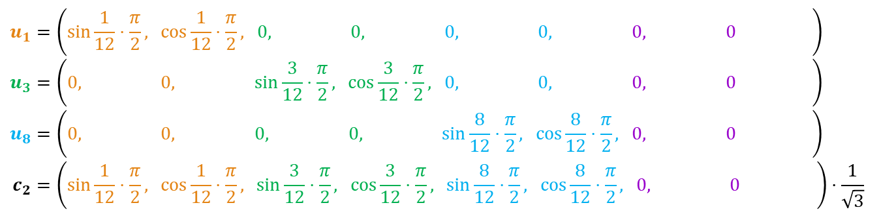





NP-Hardness of Forward-Looking
Still need: Type vectors & user constraints, to capture:
Each user (edge) is only satisfied with incident vertices (creators)
$⇒$ Do so in 8 dimensions, using edge coloring
✓
✓
$$c_{2}$$
$$u_{1}$$
$$u_{3}$$
$$u_{1}=\left(\sin{\frac{1}{12}⋅\frac{π}{2}}, \cos{\frac{1}{12}⋅\frac{π}{2}}, 0, 0, 0, 0, 0, 0 \right) \\ u_{3}=\left(0, 0, \sin{\frac{3}{12}⋅\frac{π}{2}}, \cos{\frac{3}{12}⋅\frac{π}{2}}, 0, 0, 0, 0 \right) \\ u_{8}=\left(0, 0, 0, 0, \sin{\frac{8}{12}⋅\frac{π}{2}}, \cos{\frac{8}{12}⋅\frac{π}{2}}, 0, 0 \right) \\ c_{2}=\left(\sin{\frac{1}{12}⋅\frac{π}{2}}, \cos{\frac{1}{12}⋅\frac{π}{2}}, \sin{\frac{3}{12}⋅\frac{π}{2}}, \cos{\frac{3}{12}⋅\frac{π}{2}}, \sin{\frac{8}{12}⋅\frac{π}{2}}, \cos{\frac{8}{12}⋅\frac{π}{2}}, 0, 0 \right)⋅\frac{1}{\sqrt{3}}$$
✗
$$u_{8}$$

Slide 40

Why the hardness?
Recall: “Subset Selection”
Our problem (Forward-Looking) requires:
Choosing a subset of creators (indicators $z_{j}$)
Choosing a subset of users (indicators $y_{i}$)
$$z_{1}=1$$
$$y_{3}=1$$
$$y_{4}=0$$
$$z_{4}=0$$
$$y_{i}=1\left[i∈𝒰\right]$$
$$z_{j}=1\left[j∈𝒞\right]$$

Slide 41
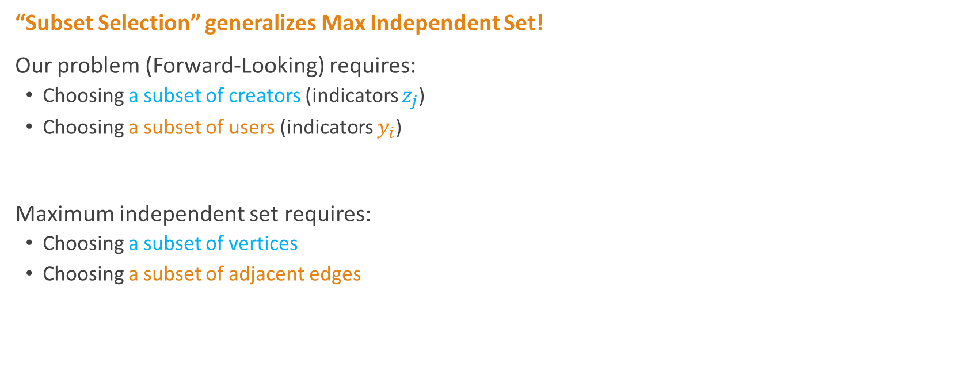
Why the hardness?
“Subset Selection” generalizes Max Independent Set!
Our problem (Forward-Looking) requires:
Choosing a subset of creators (indicators $z_{j}$)
Choosing a subset of users (indicators $y_{i}$)
Maximum independent set requires:
Choosing a subset of vertices
Choosing a subset of adjacent edges

Slide 42
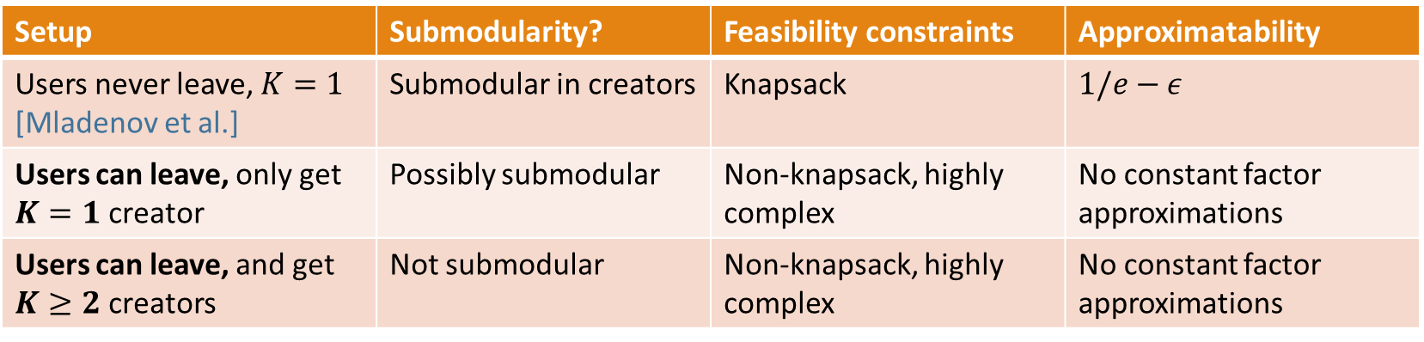

Why the hardness?
What if we have subset selection only on one side (either users or creators)?
If users never leave and get only one recommendation ($K=1$), there’s an $(1/e)$-approximation! (Shown by Mladenov et al. 2020)
Key differences: Submodularity & Knapsack constraint
Setup | Submodularity? | Feasibility constraints | Approximatability
Users never leave, $K=1$ [Mladenov et al.] | Submodular in creators | Knapsack | $$1/e−ε$$
Users can leave, only get $K=1$ creator | Possibly submodular | Non-knapsack, highly complex | No constant factor approximations
Users can leave, and get $K≥2$ creators | Not submodular | Non-knapsack, highly complex | No constant factor approximations

Slide 43
So, Forward-Looking (FL) is hard to solve…
Why not just use Immediate Engagement (IE)?

Slide 44
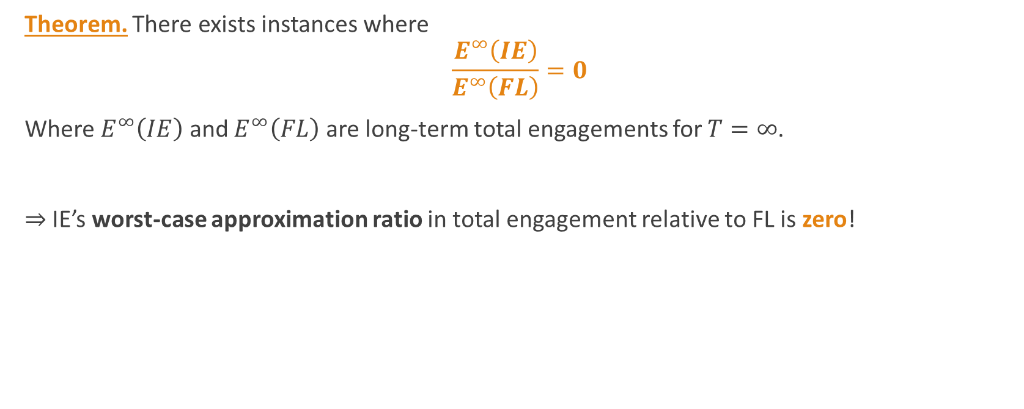
Why not just use IE?
Theorem. There exists instances where
$$\frac{E^{∞}\left(IE\right)}{E^{∞}\left(FL\right)}=0$$
Where $E^{∞}\left(IE\right)$ and $E^{∞}\left(FL\right)$ are long-term total engagements for $T=∞$.
$⇒$ IE’s worst-case approximation ratio in total engagement relative to FL is zero!

Slide 45





Example where $\frac{E^{∞}\left(IE\right)}{E^{∞}\left(FL\right)}=0$
Got $n+1$ users
Need $n+2$
Too many creators leave the platform
$n$ users
2 users
No users left!
$n$ users
Got $n+1$ users
Need $n+2$
Got 1 creator
Need 2
Immediate Engagement

Slide 46





Example where $\frac{E^{∞}\left(IE\right)}{E^{∞}\left(FL\right)}→0$
Cascade of departures
$$K=2$$
$$\overline{a}=2$$
happy
IE
not happy
FL

Slide 47





IE can also do badly on random instances
Even if users and creators are generated randomly i.i.d. from prior distributions, there are still cases where IE gets bad approximation ratios (relative to FL) in expectation!
AM2
AM2
AM2
AM1
AM1
AM1
IE
IE
IE
Increasing # users
Increasing # creators
Increasing $K$

Slide 48
Practical Algorithms
So,
Immediate Engagement (IE) has poor worst-case performance
Forward-Looking (FL) is NP-hard to solve
What can we do?
Our practical algorithms

Slide 49
Practical Algorithms
Clustering Algorithm (CA)
Assigns local matchings within clusters
Requires a Density Assumption
Achieves constant factor approximation that depends on dimensionality
Audience Maximization (AM)
Prioritize creator constraints before users
Prioritize creators that are the hardest to satisfy
Has good empirical performance in simulations

Slide 50
Thank you!
lianglyu@mit.edu
https://liang-charles-lyu.github.io/

